Slide 1
How Computer Network Can Improve the Performance of Company
Prepared by: M. Haluk Temiz

Slide 2
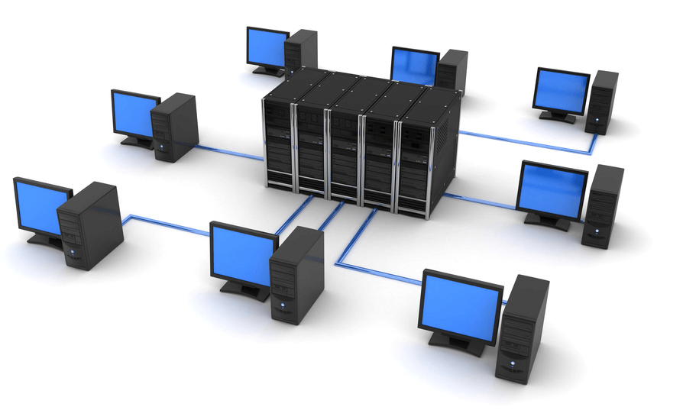
Benefits of Computer Networking
Setting up a computer network is a fast and reliable way of sharing information and resources within a business. It can help you make the most of your IT systems and equipment.

Slide 3
Advantages of Computer Networking
File sharing – you can easily share data between different users, or access it remotely if you keep it on other connected devices.
Resource sharing – using network-connected peripheral devices like printers, scanners and copiers, or sharing software between multiple users, saves money.
Sharing a single internet connection – it is cost-efficient and can help protect your systems if you properly secure the network.
Increasing storage capacity – you can access files and multimedia, such as images and music, which you store remotely on other machines or network-attached storage devices.

Slide 4
Networking computers can also help you improve communication, so that:
staff, suppliers and customers can share information and get in touch more easily
your business can become more efficient - eg networked access to a common database can avoid the same data being keyed multiple times, saving time and preventing errors
staff can deal with queries and deliver a better standard of service as a result of sharing customer data

Slide 5
Cost Benefits of Computer Networking
Storing information in one centralised database can also help you reduce costs and drive efficiency. For example:
staff can deal with more customers in less time since they have shared access to customer and product databases
you can centralise network administration, meaning less IT support is required
you can cut costs through sharing of peripherals and internet access

Slide 6
You can reduce errors and improve consistency by having all staff work from a single source of information. This way, you can make standard versions of manuals and directories available to them, and back up data from a single point on a scheduled basis, ensuring consistency.

Slide 7
Improve Network Performance
When your company’s network is too slow, it can be detrimental to your business. Not only does it hurt productivity, your leaders are likely to demand answers and a quick fix to speed things up. In fact, failing to maintain the company network to the standards that your boss expects could land you in the unemployment line.

Slide 8
Use a Network Monitoring Tool
Ironically, when users complain to you that the network is slow, it’s rarely the network itself that is the actual problem. There is usually something else happening — such as an application that’s using excessive resources causing the slowdown. Without a tool that gives you visibility into what resources are being used and where bottlenecks are occurring, you’re going to waste a lot of time on sniffing out the problem.
With a monitoring tool like AppNeta Performance Manager, which uses patented Trupath technology, you can easily find detailed diagnostic information about the problem, so you can spend more time fixing it and less time finding it. Monitoring tools also allow you to proactively identify potential issues before they create problems, so that your users rate rarely, if ever, experience network slowdowns.

Slide 9
Thanks for Listening...

