Slide 1


Computer Network
How computer network can improve the performance of public institutions or company?

Slide 2

USES OF COMPUTER NETWORKS
Had it not been of high importance, nobody would have bothered connecting computers over a network. Let's start exploring the uses of Computer Networks with some traditional usecases at companies and for individuals and then move on to the recent developments in the area of mobile users and home networking.

Slide 3
1. Resource SharIng:
The goal is to make all programs, equipments (like printers etc), and especially data, available to anyone on the network without regard to the physical location of the resource and the user.

Slide 4
2. Server-ClIent model:
One can imagine a company's information system as consisting of one or more databases and some employees who need to access it remotely. In this model, the data is stored on powerful computers called Servers. Often these are centrally housed and maintained by a system administrator. In contrast, the employees have simple machines, called Clients, on their desks, using which they access remote data.

Slide 5
3. CommunIcatIon MedIum:
A computer network can provide a powerful communication medium among employees. Virtually every company that has two or more computers now has e-mail (electronic mail), which employees generally use for a great deal of daily communication

Slide 6
4. eCommerce:
A goal that is starting to become more important in businesses is doing business with consumers over the Internet. Airlines, bookstores and music vendors have discovered that many customers like the convenience of shopping from home. This sector is expected to grow quickly in the future.

Slide 7
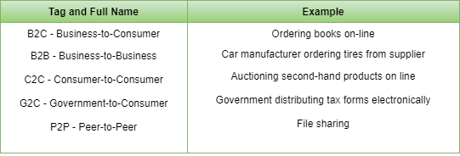
The most popular forms are listed in the below figure:

Slide 8
BENEFITS OF NETWORKS
Networks can allow businesses to reduce expenses and improve efficiency by sharing data and common equipment, such as printers, among many different computers. While printers can be shared in other ways, such as by carrying information on floppy disks from one PC to another, or using manual or electronic data switches, networks have the capacity to accommodate more users with less frustration. The power of mainframes or minicomputers can be used in harmony with personal computers.

Slide 9
The larger machines can process larger and more complex jobs, such as maintaining the millions of records needed by a national company, while individual PCs manned by individual users handle smaller jobs such as word processing. And older equipment can be rotated to less demanding jobs as workstations are upgraded. Many software programs also offer license agreements for networks, which can be more cost effective than purchasing individual copies for each machine. The costs of implementing a network depend on issues of performance, compatibility, and whether value must be added to a turnkey system through additional programming or the addition of special components.

