Slide 1
Computer Network In Public Administration
ANIL DOLGUN

Slide 2
The increasing importance of computer networks for the future of our economic and social system is the result of three fundamental developments in recent years:
Sinking prices, improving performance and advancing miniaturization of components are the basic characteristics of the computer market. Consequently, the number of ICT- equipped work places in industry and administration has risen as steadily as the number of PCs in private households. Thus the number of potential users of computer networks has multiplied.

Slide 3
For many years communication between computers from different manufacturers was either impossible or entailed a great deal of effort and expense. Meanwhile national and international norms and standards have driven out manufacturer specific network concepts.
Improved and continually upgraded infrastructures of transferring data have enabled transmission rates to increase. With the disappearance of the monopolies enjoyed by national telecommunications companies competing suppliers are entering the telecommunications market, bringing a further increase in the number of available data transmission routes.

Slide 4
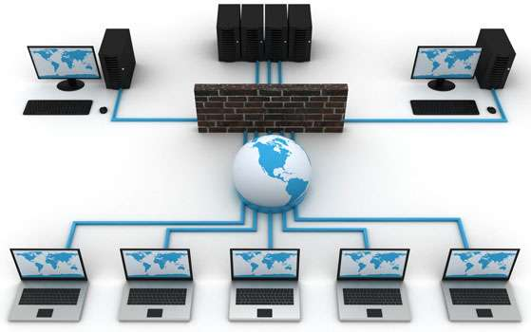
Nowadays computer networks are a part of everyone's vocabulary with the most diverse of associations: the spectrum ranges from the Internet with its dizzying growth, through the complex systems in industry and administration, to the comparatively unspectacular local networking of a few PCs.

Slide 5
In order to avoid misunderstandings a typology of the various meanings seems to be essential. We propose differentiating between four types of network based applications which reflect the different aims of the networks and also create different requirements with respect to interorganizational coordination:
Resource sharing: hard- or software is used by various network participants, for example: voluminous tasks can be shared between a number of computers, data can be stored on an external system or programmes can be called-up from a server;
Support of transactions: a network is used for the execution of specific administrative procedures, which are undertaken in spatially remote places;

Slide 6
Improvement of communication: texts and other documents are exchanged between at least two active participants, or processed simultaneously;
Access to information: through networks it is possible to access information irrespective of the place of storage.
Even this short description of network based applications makes two things clear: firstly, the realization of the four types calls for different coordination needs. Secondly, use of these systems in practical administrative work changes interorganizational coordination in differing degrees.

Slide 7
In Turkey
Communication is a system that senders have possibility to send message to receiver in general meaning. It is considered that as a modern Turkish economy should use communication systems largely. It is critically important to show Turkey’s usage of communication technologies as a country that keeps up with new developments in the world.
Turkey is a improved country as economically and population, but this situtation is not reflected in the computer network. There is a lack of communication in all areas of public administration. And this situtation reflects to public services.

Slide 8
Thanks for Listening

